Slide 1
Crop Production Analysis in INDIA

Slide 2
Introduction
The Agriculture business domain, as a vital part of the overall supply chain, is expected to highly evolve in the upcoming years via the developments, which are taking place on the side of the Future Internet.
This paper presents a novel Business-to-Business collaboration platform from the agri-food sector perspective, which aims to facilitate the collaboration of numerous stakeholders belonging to associated business domains, in an effective and flexible manner.

Slide 3
Details OF data
State Name
District Name
Crop Year
Season
Crop
Area
Production

Slide 4
Main KPI’S
Total Area – Sum of all the Area crops covered – 3 Billions
Total Production – Sum of all the Production cost – 141 Billions
Total Districts – 646
Total State – 33

Slide 5
Insights
UP had large area invested in Crop Production than other states.
In 2012, Production of Crops were highest than other years which was 14.31B.
Areawise, Rice had most area of 747M msq. Covered and Wheat is second highest 471M msq.
Production Wise, Coconut has highest production of 129,982M, second is Sugarcane with 5,536M.
Season wise, Arecanut, Banana, Black Pepper, Cardamom, Cashew Nut, Coconut, Coriander, Dry Chillies, Dry Ginger, Garlic, Oilseeds Total, Onion, Potato, Pulses Total, Sannhamp, Sugarcane, Sweet Potato, Tapioca, Tobacco, Turmeric are whole year crops.

Slide 6
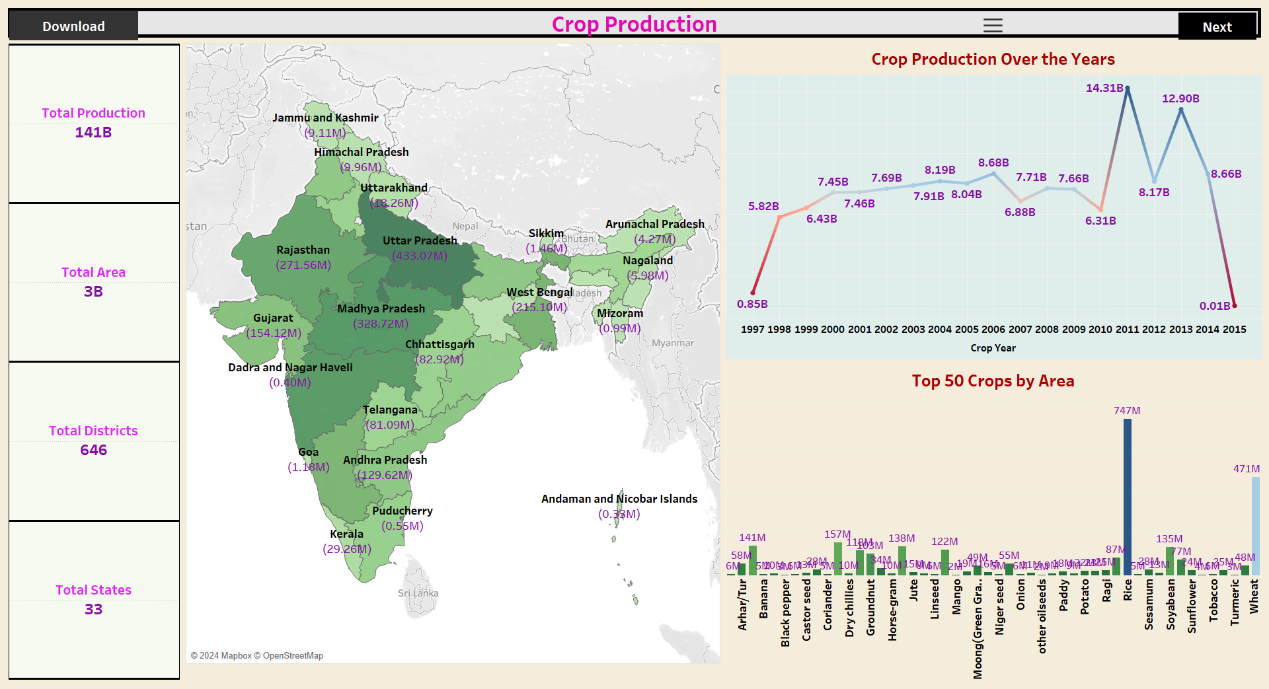
Mock – up dashboard

Slide 7
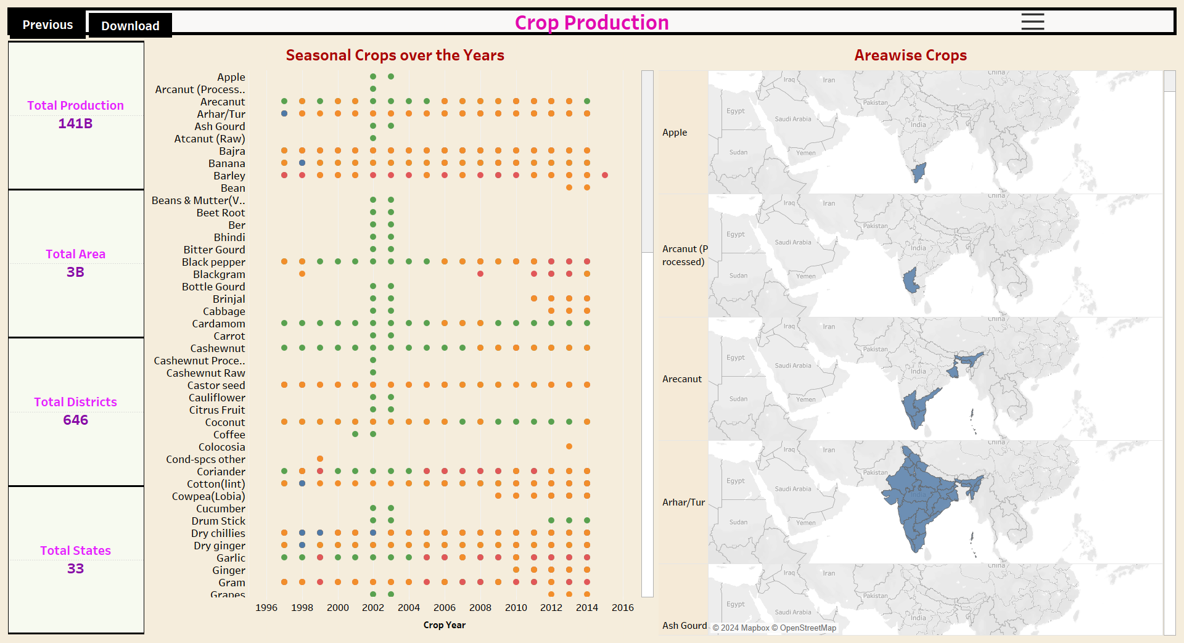
My Designs

Slide 8


